Slide 1
UPPER SIXTH ARTS
GEOGRAPHY
Map Analysis 3
Relief on Maps
Notes:
Good morning, class, and welcome to our geography lesson. I am your geography teacher, Mr Kamdem. Today we are starting Map Analysis 3: Relief on Maps.

Slide 2
CLASS INFO
Class, Chapter and Duration
Class | Upper Sixth Arts
Chapter | Module 8: Understanding and carrying out statistical techniques, topographic map analysis, fieldwork and project based learning
Duration | 2 periods (2 × 50 minutes)
Notes:
This lesson is for Upper Sixth Arts. It belongs to Module 8: Understanding and carrying out statistical techniques, topographic map analysis, fieldwork and project based learning. We shall need 2 periods to cover it.

Slide 3
IDENTIFICATION
Lesson Identification
Topic | Topographic Map Analysis
Sub-topic | Geomorphological Analysis
Lesson | Map Analysis 3: Relief on Maps
Notions / Concepts | Relief, landform, spur, valley, escarpment, plateau, cross-section, relief region, floodplain, meander, cliff, spit.
Syllabus focus | Contour patterns and landforms; relief regions (sketch, description, explanation); fluvial features and drainage; coastal landforms.
Competence | Learners are able to identify landforms, draw cross-sections and describe relief regions from a map.
Notes:
Our topic is Topographic Map Analysis, and the sub-topic is Geomorphological Analysis. The key notions we shall use today are: relief, landform, spur, valley, escarpment, plateau, cross-section, relief region, floodplain, meander, cliff, spit. At the end, you should be able to do this: learners are able to identify landforms, draw cross-sections and describe relief regions from a map.

Slide 4

HOMEWORK CORRECTION
Correction of the Homework
Question (Map Analysis 2: Remote Sensing, Aerial Photographs and GIS):
Use a phone map app to find your school and describe the land use around it.
Notes:
Before we start the new lesson, let us correct the homework I gave you at the end of Map Analysis 2: Remote Sensing, Aerial Photographs and GIS. The question was: Use a phone map app to find your school and describe the land use around it. Take out your exercise books.

Slide 5
HOMEWORK CORRECTION
Correction: Possible Answer
Answers vary. Describe the land use around the school on the satellite view: houses to the north, a main road to the east, farms or open land to the south, and trees along a stream.
Notes:
Here is a good answer. Answers vary. Describe the land use around the school on the satellite view: houses to the north, a main road to the east, farms or open land to the south, and trees along a stream. Compare it with your own answer and correct your work in red.

Slide 6
LESSON PLAN
Lesson Plan
Correction of the homework
Objectives and recall
Real-life situation and action to take
Learning activities
Board summary
Evaluation, remediation and homework
Notes:
Here is the plan of our lesson today. First, we shall correct the homework. Then we shall look at the objectives and recall what you already know. After that, we shall study a situation from real life and the action to take, and do the learning activities. Finally, we shall copy the board summary, do the evaluation and the remediation, and I will give you the homework.

Slide 7
OBJECTIVES
Objectives
By the end of this lesson, you should be able to:
Identify landforms from contour patterns.
Draw a cross-section and a relief sketch map.
Notes:
Take your time to copy this part; we will continue together.

Slide 8
OBJECTIVES
Objectives (continued)
Identify fluvial and coastal landforms on maps.
Notes:
By the end of this lesson, you should be able to do three things. Number 1: identify landforms from contour patterns. Number 2: draw a cross-section and a relief sketch map. Number 3: identify fluvial and coastal landforms on maps.

Slide 9
PREVIOUS KNOWLEDGE
Previous Knowledge
Contours show height.
Close contours show steep slopes.
Notes:
Let us first remember what you already know. Contours show height. Close contours show steep slopes. Keep this in mind, because we shall build on it today.

Slide 10
REAL-LIFE SITUATION
Situation in Real Life
In the GCE exam, students are asked to draw a sketch map of the relief regions of a map extract, draw a cross-section from X to Y and identify landforms along the river and the coast.
Notes:
Listen carefully to this situation from real life. In the GCE exam, students are asked to draw a sketch map of the relief regions of a map extract, draw a cross-section from X to Y and identify landforms along the river and the coast. Think about it, because I am going to ask you some questions.

Slide 11
REAL-LIFE SITUATION
Situation: Question 1
What is the problem in the situation?
Notes:
Question 1: What is the problem in the situation? Think for a moment, then raise your hand to answer.

Slide 12
REAL-LIFE SITUATION
Answer
Students must analyse relief on a map.
Notes:
Good. Students must analyse relief on a map.

Slide 13
REAL-LIFE SITUATION
Situation: Question 2
What shows landforms on a map?
Notes:
Question 2: What shows landforms on a map? Think for a moment, then raise your hand to answer.

Slide 14
REAL-LIFE SITUATION
Answer
Contour patterns.
Notes:
Good. Contour patterns.

Slide 15
REAL-LIFE SITUATION
Situation: Question 3
What drawing shows the shape of land along a line?
Notes:
Question 3: What drawing shows the shape of land along a line? Think for a moment, then raise your hand to answer.

Slide 16
REAL-LIFE SITUATION
Possible Answer
A cross-section.
Notes:
Good. A cross-section.

Slide 17
ACTION TO TAKE
Action to Take
Describe relief with map evidence: heights, grid references and directions.
Notes:
From this situation, the action we are working towards in this lesson is the following: describe relief with map evidence: heights, grid references and directions.

Slide 18
JUSTIFICATION
Justification of the Lesson
This lesson helps us to describe and explain relief from map evidence.
Notes:
Why is this lesson important for you? This lesson helps us to describe and explain relief from map evidence.

Slide 19
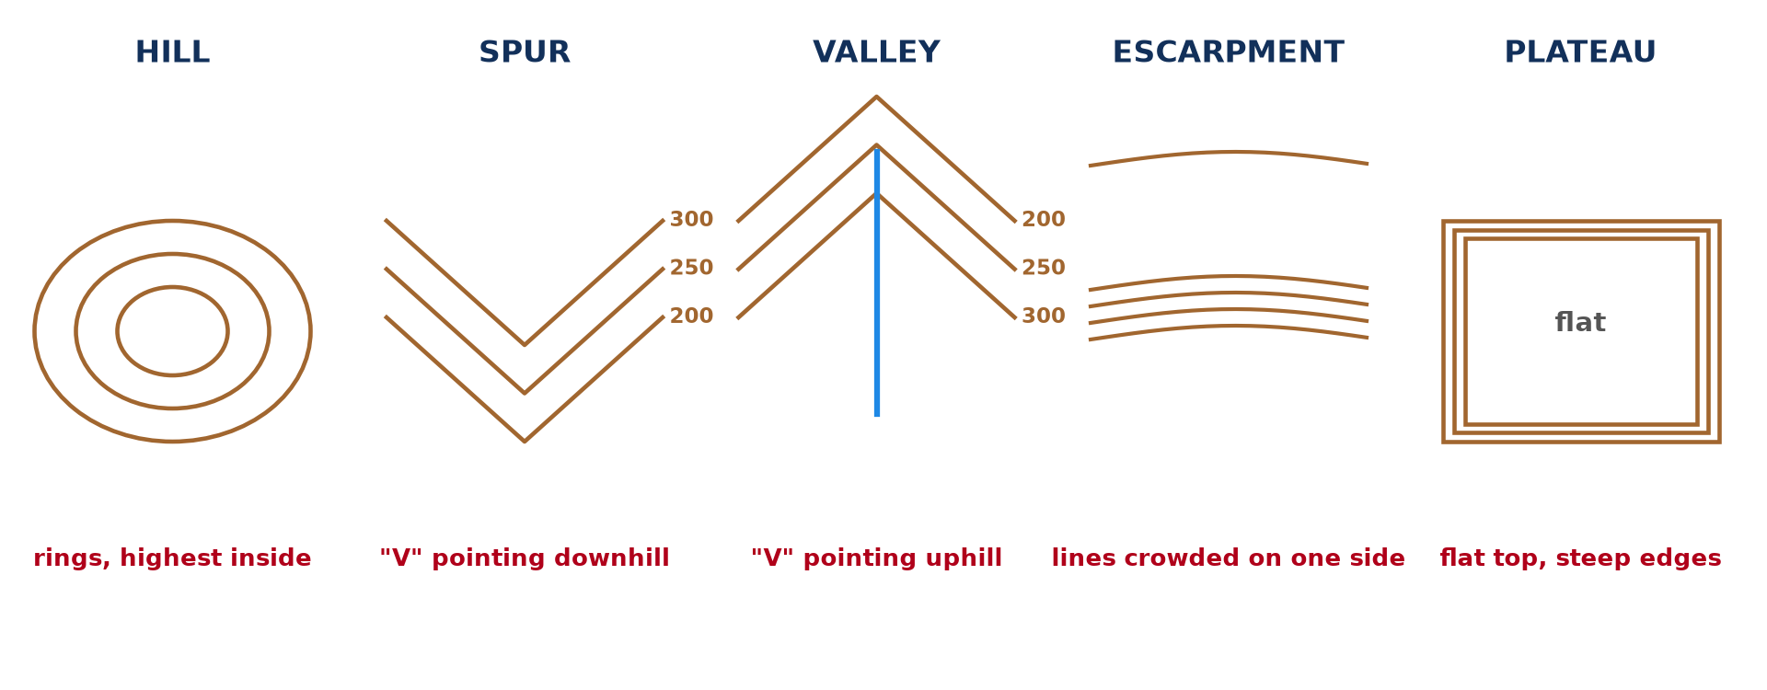
1. CONTOUR PATTERNS
Activity 1
Landforms from contours.
Notes:
Activity 1. Look carefully at this diagram: landforms from contours. Observe every detail before I ask the question.

Slide 20
1. CONTOUR PATTERNS
Activity 1: Question
How can you tell a spur from a valley?
Notes:
Here is the question for Activity 1: How can you tell a spur from a valley? Take one minute to think and write your answer in your rough notebook.

Slide 21
1. CONTOUR PATTERNS
Activity 1: Answer
A spur's contours point downhill; a valley's point uphill and often contain a river.
Notes:
Let us check the answer together. A spur's contours point downhill; a valley's point uphill and often contain a river.

Slide 22

2. RELIEF REGIONS
Activity 2
A relief extract (invented).
Notes:
Activity 2. Look carefully at this diagram: a relief extract (invented). Observe every detail before I ask the question.

Slide 23
2. RELIEF REGIONS
Activity 2: Question
Name the relief regions on the extract.
Notes:
Here is the question for Activity 2: Name the relief regions on the extract. Take one minute to think and write your answer in your rough notebook.

Slide 24
2. RELIEF REGIONS
Activity 2: Answer
A highland in the north-west, a river valley, a lowland plain and an isolated hill in the south-east.
Notes:
Let us check the answer together. A highland in the north-west, a river valley, a lowland plain and an isolated hill in the south-east.

Slide 25
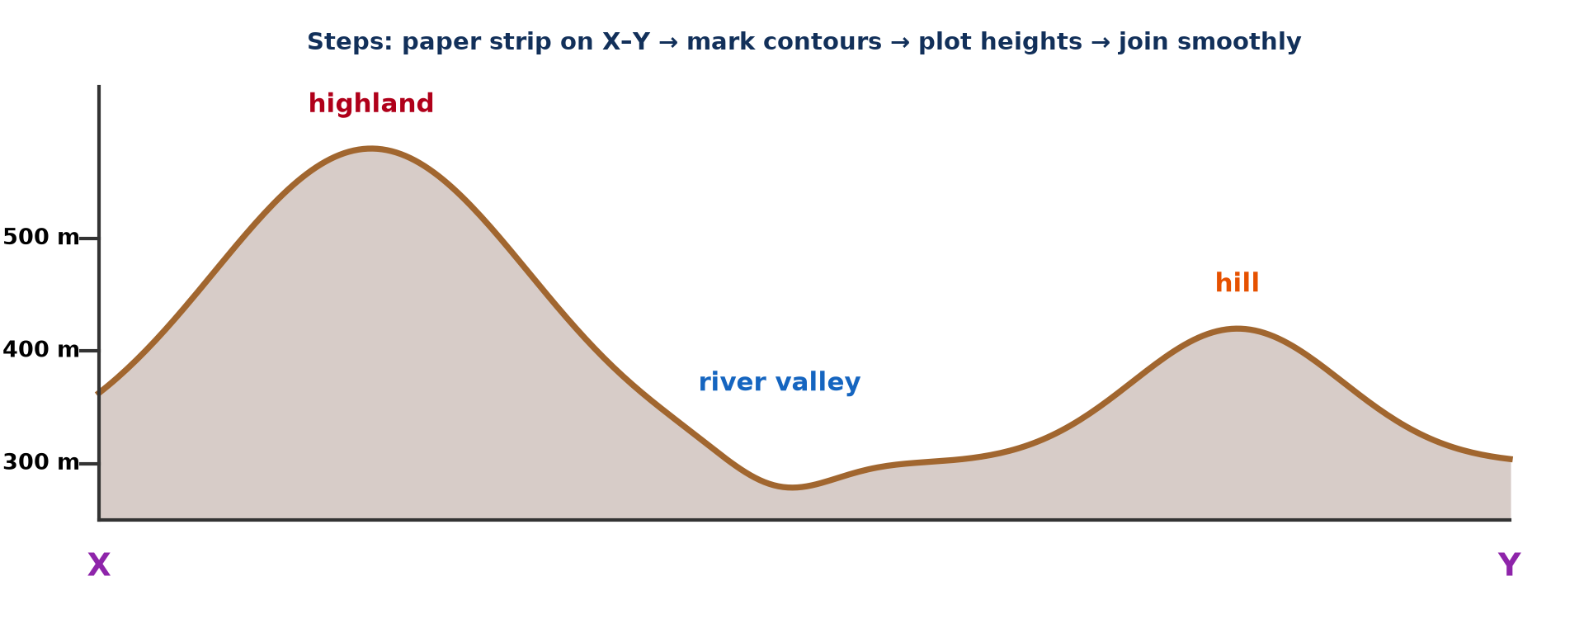
2. CROSS-SECTION
Activity 3
Cross-section X–Y.
Notes:
Activity 3. Look carefully at this diagram: cross-section X–Y. Observe every detail before I ask the question.

Slide 26
2. CROSS-SECTION
Activity 3: Question
Give the steps to draw a cross-section.
Notes:
Here is the question for Activity 3: Give the steps to draw a cross-section. Take one minute to think and write your answer in your rough notebook.

Slide 27
2. CROSS-SECTION
Activity 3: Answer
Place a paper strip on X–Y, mark contours, plot heights on a graph and join them smoothly.
Notes:
Let us check the answer together. Place a paper strip on X–Y, mark contours, plot heights on a graph and join them smoothly.

Slide 28
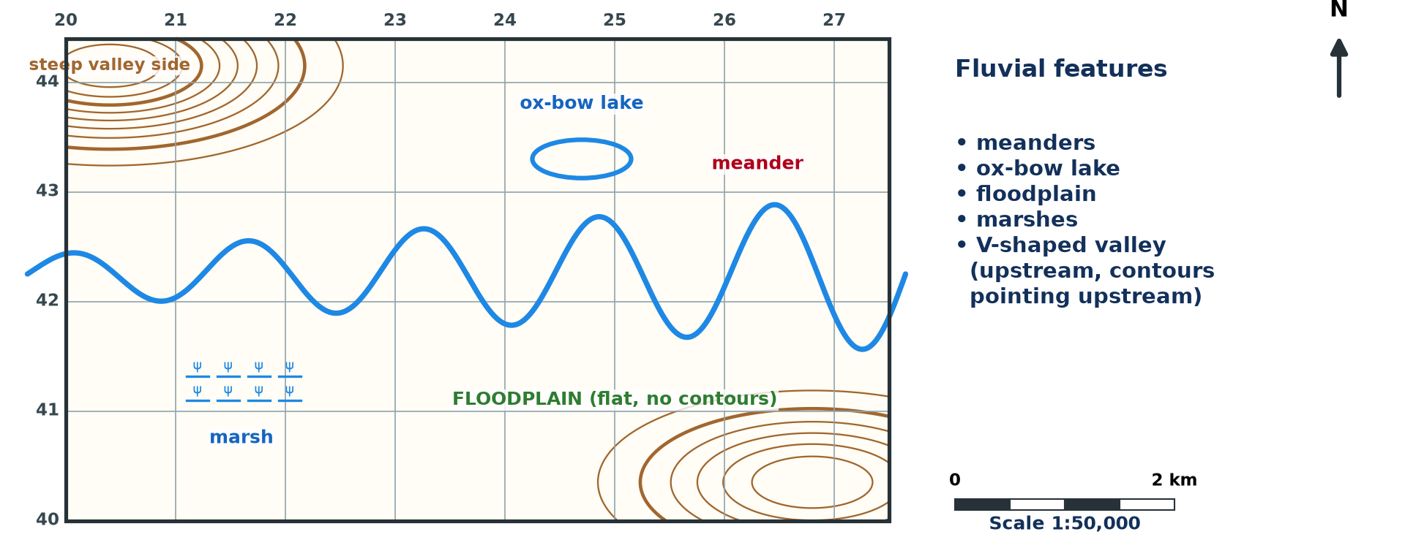
3. FLUVIAL FEATURES
Activity 4
River features (invented).
Notes:
Activity 4. Look carefully at this diagram: river features (invented). Observe every detail before I ask the question.

Slide 29
3. FLUVIAL FEATURES
Activity 4: Question
Name three fluvial features shown.
Notes:
Here is the question for Activity 4: Name three fluvial features shown. Take one minute to think and write your answer in your rough notebook.

Slide 30
3. FLUVIAL FEATURES
Activity 4: Answer
Meanders, an ox-bow lake and a floodplain with marshes.
Notes:
Let us check the answer together. Meanders, an ox-bow lake and a floodplain with marshes.

Slide 31
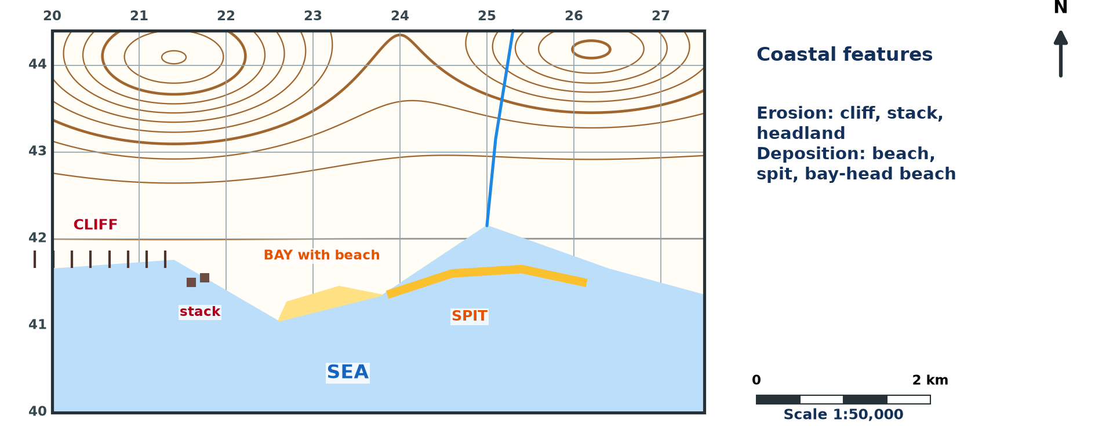
4. COASTAL LANDFORMS
Activity 5
Coastal features (invented).
Notes:
Activity 5. Look carefully at this diagram: coastal features (invented). Observe every detail before I ask the question.

Slide 32
4. COASTAL LANDFORMS
Activity 5: Question
Name one erosional and one depositional coastal landform.
Notes:
Here is the question for Activity 5: Name one erosional and one depositional coastal landform. Take one minute to think and write your answer in your rough notebook.

Slide 33
4. COASTAL LANDFORMS
Activity 5: Answer
Erosional: cliff (or stack). Depositional: spit (or beach).
Notes:
Let us check the answer together. Erosional: cliff (or stack). Depositional: spit (or beach).

Slide 34
BOARD SUMMARY
Board Summary
Topic: Topographic Map Analysis
Sub-topic: Geomorphological Analysis
Map Analysis 3: Relief on Maps
Notes:
Now we are going to copy the board summary. Write the title and the headings neatly in your notebooks. I will give you enough time for each slide, so do not rush.

Slide 35
BOARD SUMMARY
1. Contour Patterns and Landforms
Landforms are identified from contour patterns as follows:
Spur and valley: A spur has V-shaped contours pointing downhill, while a valley has V-shaped contours pointing uphill. Rivers usually flow in the valleys.
Notes:
Let us copy Contour Patterns and Landforms. Landforms are identified from contour patterns as follows. On this slide we have Spur and valley. Write each point on a new line, with the key term first, and explain it in your own words when we revise. When you finish, we go to the next slide.

Slide 36
BOARD SUMMARY
1. Contour Patterns and Landforms (continued)
Hills and plateaux: A hill has closed contours rising to a summit. A plateau has a flat top with steep edges, and an escarpment has close contours on one side only.
Notes:
We continue with Contour Patterns and Landforms. On this slide we have Hills and plateaux. Write each point on a new line, with the key term first, and explain it in your own words when we revise.

Slide 37
BOARD SUMMARY
1. Contour Patterns and Landforms
Illustration: landforms from contours
Notes:
Now draw this illustration in your notebook: landforms from contours. Give it a title and label it clearly.

Slide 38
BOARD SUMMARY
2. Relief Regions and Cross-sections
Relief regions are described and drawn as follows:
Relief regions: They are areas with similar height and slope, such as highlands, plateaux, valleys and plains. They are shown on a sketch map with a frame, key, scale and north arrow.
Notes:
Let us copy Relief Regions and Cross-sections. Relief regions are described and drawn as follows. On this slide we have Relief regions. Write each point on a new line, with the key term first, and explain it in your own words when we revise. When you finish, we go to the next slide.

Slide 39
BOARD SUMMARY
2. Relief Regions and Cross-sections (continued)
Description and explanation: Each region is described by its location, height, slope and landforms, with map evidence. Its origin is then explained by erosion, deposition or tectonics.
Notes:
We continue with Relief Regions and Cross-sections. On this slide we have Description and explanation. Write each point on a new line, with the key term first, and explain it in your own words when we revise. When you finish, we go to the next slide.

Slide 40
BOARD SUMMARY
2. Relief Regions and Cross-sections (continued)
Cross-section: A paper strip is placed along the line, the contours are marked and plotted on a graph. The points are joined smoothly and the landforms labelled.
Notes:
We continue with Relief Regions and Cross-sections. On this slide we have Cross-section. Write each point on a new line, with the key term first, and explain it in your own words when we revise.

Slide 41
BOARD SUMMARY
2. Relief Regions and Cross-sections
Illustration: cross-section X–Y
Notes:
Now draw this illustration in your notebook: cross-section X–Y. Give it a title and label it clearly.

Slide 42
BOARD SUMMARY
3. Fluvial Features and Drainage
River features on maps are identified as follows:
Erosional features: V-shaped valleys, waterfalls and rapids are found in the upper course. They are shown by close contours across the river.
Notes:
Let us copy Fluvial Features and Drainage. River features on maps are identified as follows. On this slide we have Erosional features. Write each point on a new line, with the key term first, and explain it in your own words when we revise. When you finish, we go to the next slide.

Slide 43
BOARD SUMMARY
3. Fluvial Features and Drainage (continued)
Depositional features: Meanders, ox-bow lakes, floodplains and marshes are found in the lower course. They occur where contours are widely spaced.
Notes:
We continue with Fluvial Features and Drainage. On this slide we have Depositional features. Write each point on a new line, with the key term first, and explain it in your own words when we revise.

Slide 44
BOARD SUMMARY
4. Coastal Landforms
Coastal landforms on maps are identified as follows:
Erosional landforms: Cliffs, headlands, bays and stacks show wave erosion. Cliffs are shown by very close contours or a cliff symbol along the coast.
Notes:
Let us copy Coastal Landforms. Coastal landforms on maps are identified as follows. On this slide we have Erosional landforms. Write each point on a new line, with the key term first, and explain it in your own words when we revise. When you finish, we go to the next slide.

Slide 45
BOARD SUMMARY
4. Coastal Landforms (continued)
Depositional landforms: Beaches, spits, bars and mangrove swamps show deposition. They are found in sheltered bays and estuaries.
Notes:
We continue with Coastal Landforms. On this slide we have Depositional landforms. Write each point on a new line, with the key term first, and explain it in your own words when we revise.

Slide 46
BOARD SUMMARY
4. Coastal Landforms
Illustration: coastal features (invented)
Notes:
Now draw this illustration in your notebook: coastal features (invented). Give it a title and label it clearly.

Slide 47
FORMATIVE EVALUATION
Evaluation 1
Describe the contour pattern of a plateau.
Notes:
Now let us check what you have understood. Question 1: Describe the contour pattern of a plateau. Answer in your exercise book.

Slide 48
FORMATIVE EVALUATION
Expected Answer
Flat top with widely spaced contours and crowded contours at the edges.
Notes:
The expected answer is: flat top with widely spaced contours and crowded contours at the edges. If you got it right, well done.

Slide 49
FORMATIVE EVALUATION
Evaluation 2
Name two fluvial features of the lower course.
Notes:
Now let us check what you have understood. Question 2: Name two fluvial features of the lower course. Answer in your exercise book.

Slide 50
FORMATIVE EVALUATION
Expected Answer
Meanders and ox-bow lakes.
Notes:
The expected answer is: meanders and ox-bow lakes. If you got it right, well done.

Slide 51
REMEDIATION
Remediation
Fill in the blanks:
Contours pointing downhill show a ______.
A side view of land is a cross-______.
A curved ridge of sand into the sea is a ______.
Notes:
For those who need more practice, fill in the blanks in your exercise book. The answers are: number 1, spur; number 2, section; number 3, spit.

Slide 52
HOMEWORK
Homework
Draw the cross-section X–Y from the extract and label the landforms.
Notes:
For your homework: Draw the cross-section X–Y from the extract and label the landforms. We shall correct it at the beginning of our next lesson.

Slide 53
NEXT LESSON
Next Lesson
Our next lesson will be on:
Map Analysis 4: Drainage on Maps
Notes:
Our next lesson will be on Map Analysis 4: Drainage on Maps. Thank you for your attention, and see you next time.

Slide 54
BILINGUAL GAME
Bilingual Game (Jeu Bilingue)
English | Français
Relief | Le relief
Cross-section | La coupe topographique
Spur | L'éperon
Valley | La vallée
Cliff | La falaise
Plateau | Le plateau
Notes:
Let us play the bilingual game. I say a word in English, and you give me the French word. Then we do the reverse.

Slide 55
LOGBOOK
Official Logbook (1/2)
Module / Topic | Topographic Map Analysis
Lesson Title | Map Analysis 3: Relief on Maps
Expected Learning Outcomes | Identify landforms from contour patterns. Draw a cross-section and a relief sketch map. Identify fluvial and coastal landforms on maps.
Competence | Learners are able to identify landforms, draw cross-sections and describe relief regions from a map.
Notes:
I record this information in the official logbook of the class after the lesson.

Slide 56
LOGBOOK
Official Logbook (2/2)
Matter Taught | Contour Patterns and Landforms; Relief Regions and Cross-sections; Fluvial Features and Drainage; Coastal Landforms.
Evaluation | Formative evaluation and remediation exercise.
Homework | Draw the cross-section X–Y from the extract and label the landforms.
Enrolment / Present / Absent | ____ / ____ / ____
Achievement | To be completed after the lesson.
Notes:
I complete the second page of the logbook: the matter taught, the evaluation, the homework and the attendance.

Slide 57
TEACHER'S NOTE
Teacher's Note
Timing: Homework correction, plan, objectives 8 min | Recall, situation, action 10 min | 5 activities 30 min | Board summary (copying) 30 min | Evaluation, remediation 10 min | Homework, next lesson 5 min | Logbook 7 min
Without the projector (Activity 1): draw both.
Without the projector (Activity 2): sketch the regions.
Without the projector (Activity 3): draw a section.
Without the projector (Activity 4): identify features.
Without the projector (Activity 5): identify features.
Notes:
This slide is for me, the teacher: it gives the timing of the lesson and what to do if the projector is not available.

Slide 58
REFERENCES
References
National Geography Syllabus, MINESEC/IGE/IP-SS, 2019 — Module 8 (Practical Geography).
Diagrams and animations: drawn for this lesson (Geography Department).
Notes:
These are the references and picture credits used to prepare this lesson.

